Slide 1
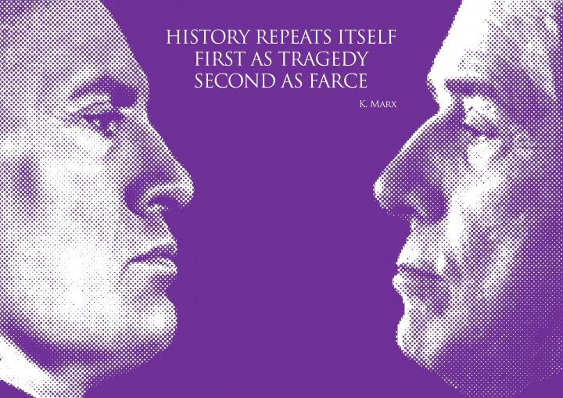

Slide 2
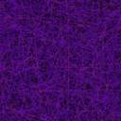
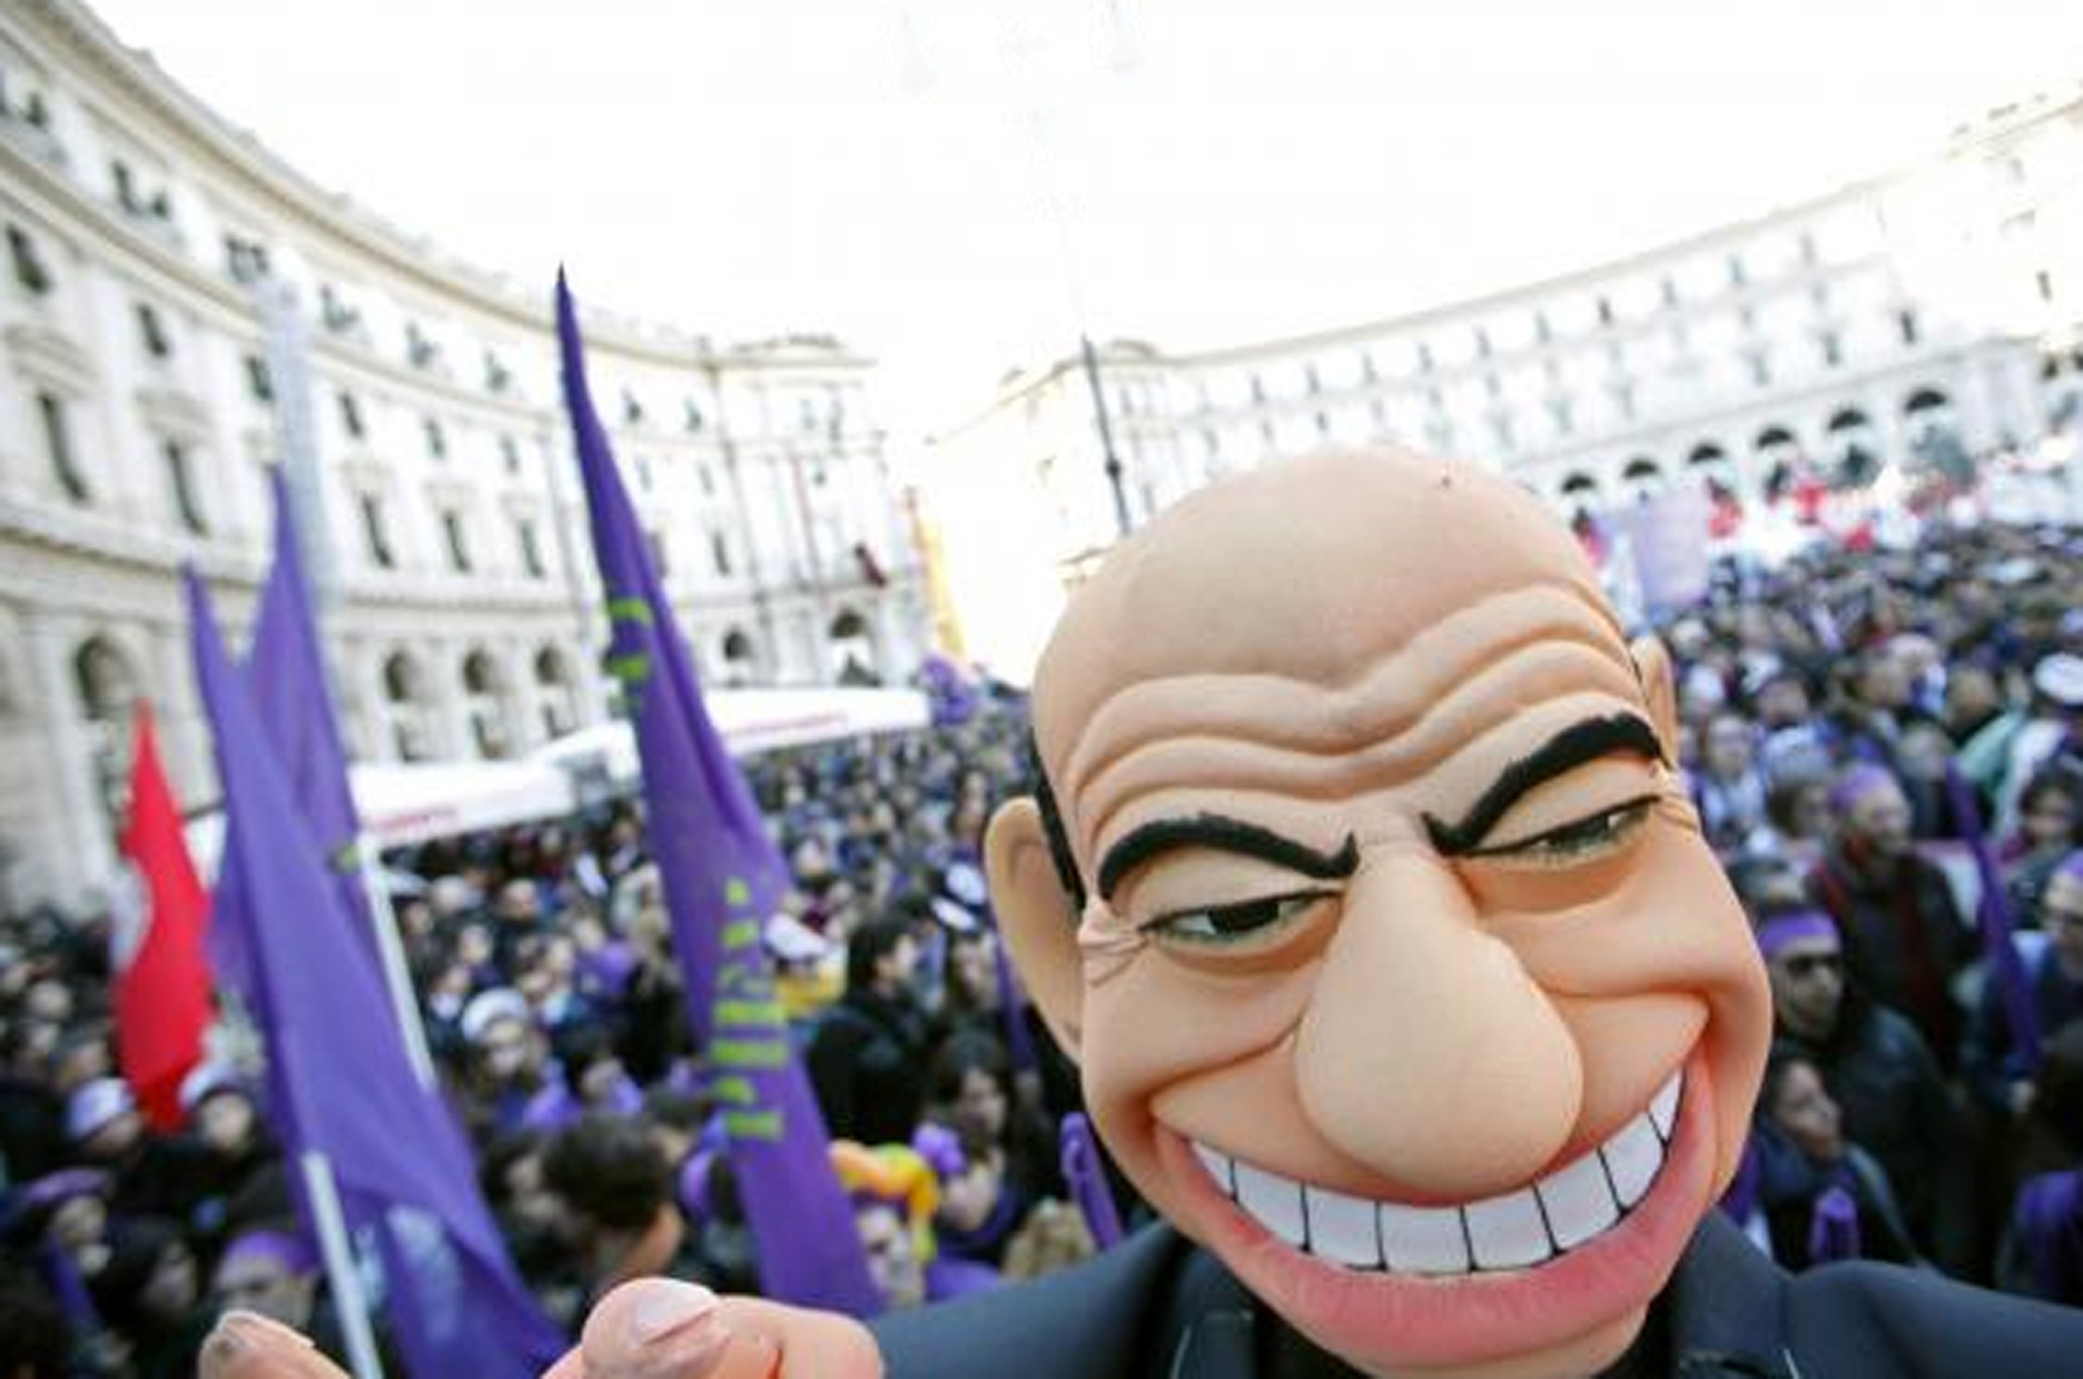
5th Dec 09: No-Berlusconi Day
Hundreds of Thousands protesters in Rome, London, Berlin, Paris, Barcelona, New York, Los Angeles, Sydney and other cities around the world
Popolo Viola: Purple Movement
Born on Facebook as an anti-Berlusconi movement, developed quickly a hybrid and complex identity: Anti-Corruption, Anti-Mafia, Anti-Fascism, pro-Workers’ Rights, Research, Culture, and Education (Berlusconism)
Facebook Page “il Popolo Viola”:
44,000 members (first day)
198,000 members (January 2010)
450,000 members (May 2012)
2011-2012: Berlusconi’s resignation, internal struggles, loss of credibility, decline
Q: How does the use of Facebook influence development of the purple movement throughout its life cycle?
Facebook and
the anti-berlusconi
movement
in italy

Slide 3
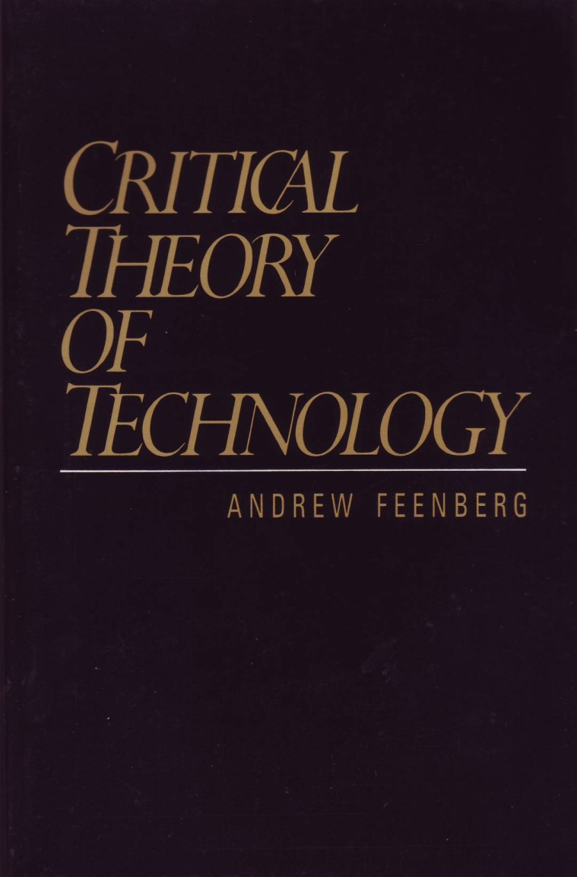
- Critical Theory of Technology
Technical Code (Feenberg, 2005)
- Social Movement Theory
SMOs Life cycles (Dawson and Gettys, 1929; Della Porta and Diani, 2006)
Unrest (1994-2009)
Excitement (NoBDay>1st scission)
Formalization (>Non-Profit)
Institutionalization(>2nd scission)
Decline (or re-formalisation)
Collective Identity (Melucci, 2001; Polletta, 2001)
- Methodology
In-Depth Interviews
Content Analysis
Historical Trend Analysis
Survey
Theoretical framework
& methodology

Slide 4
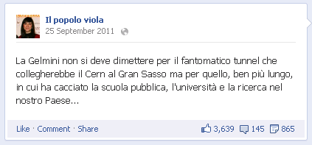
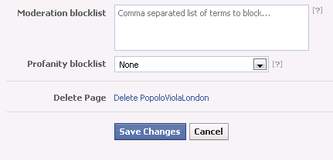
Dialogue or Trialogue?
PV posts: 480.8 likes, 216.4 comments
  Users’ posts: 0.21 likes, 0.12 comments
  (1218 – 591 – 532 – 341)
- Conversation takes place on individual users’ Newsfeed, not on the page (30 to 1)
  - Only PV updates show up on Newsfeed
Is this a discussion?
  - Only very few comments are ‘conversational’
  (12.4% - 11% - 9.2% - 8%)
  Almost none of the comments hold information (6.5% - 6% - 6.2% - 5.8%)
The Admins’ War
- (past) Any administrator was able to remove subscribers or to make them administrators themselves (1st scission)
- (present) Any administrator can exclude any other administrator, founder included (2nd scission)
When facebook ‘is´ the movement

Slide 5
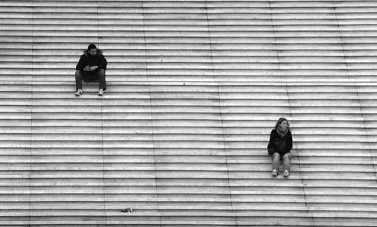
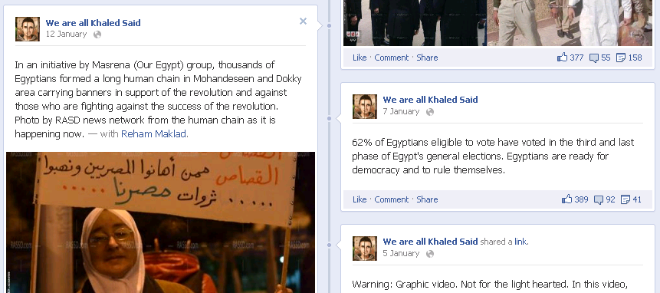
- Absence of trialogue
- Absence of discussion
- Vertical > Horizontal Communication
>
1) Disintegration of Collective Identity building process
Q: is really Facebook horizontal?
- Lack of Democratic Management of Facebook pages
- Need for centralised organising processes
- Formalisation – Institutionalisation Loop
>
2) Negative influence of ideological clash on medium – long term strategies of SMs
Q: is it just a coincidence that the
most effective Facebook protests
took place in countries where FB
ideologies were closer to the
meta-values of SMs?
To resume …

