Slide 1
GLOBAL SUSTAINABLE INFORMATION SOCIETY
Vision for the Future
Wolfgang Hofkirchner

Slide 2
Contents
1 Social Systems
2 Individualisation and Socialisation
3 Individualism and Collectivism
4 Global Challenges
5 Global Sustainable Information Society

Slide 3
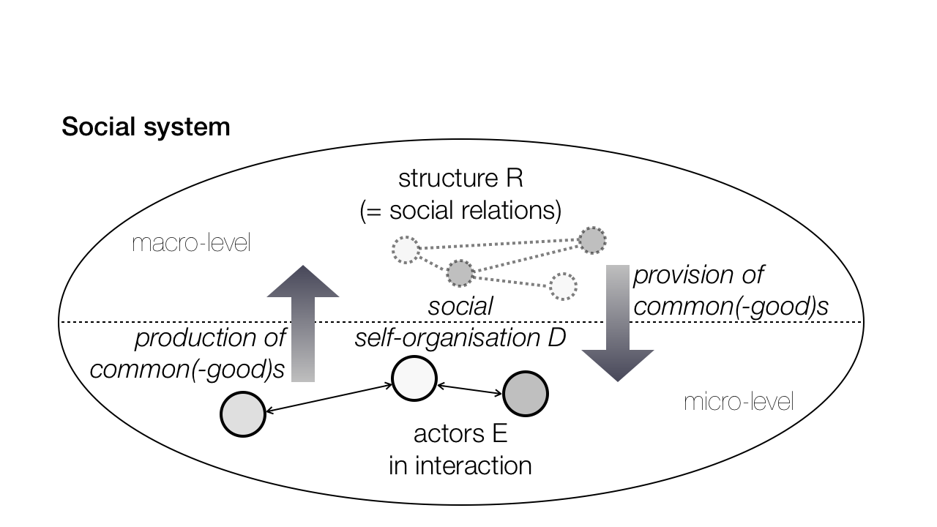
1 Social Systems

Slide 4
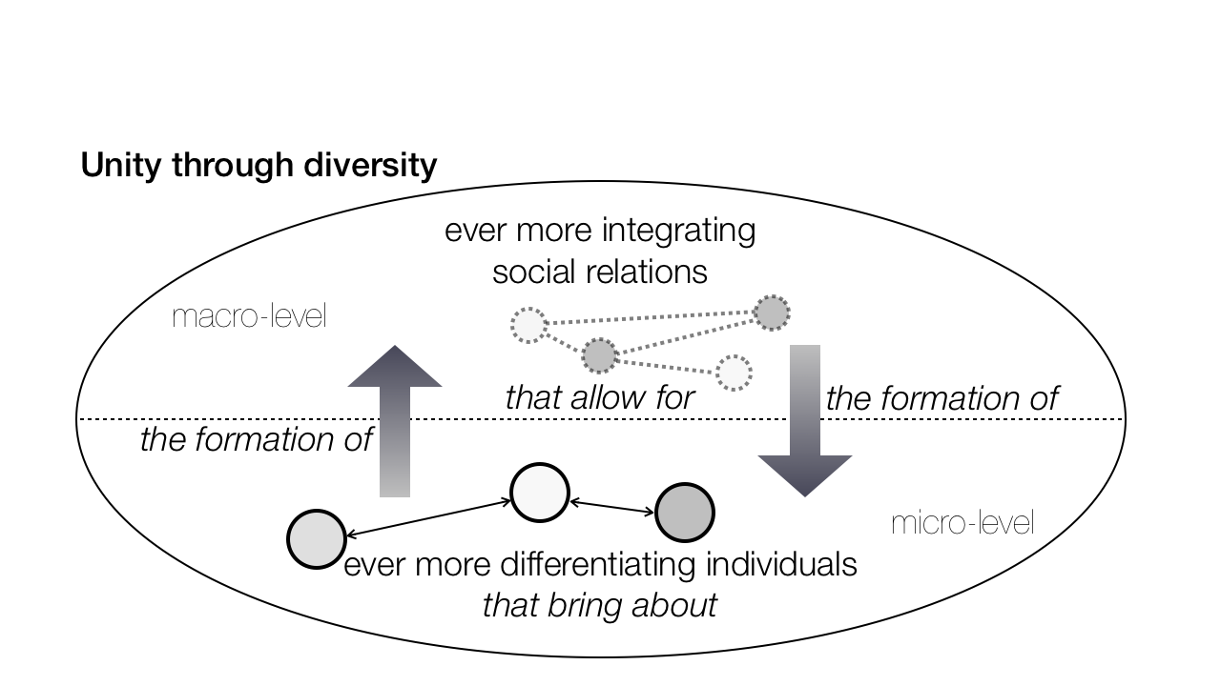
2 Individualisation and socialisation

Slide 5
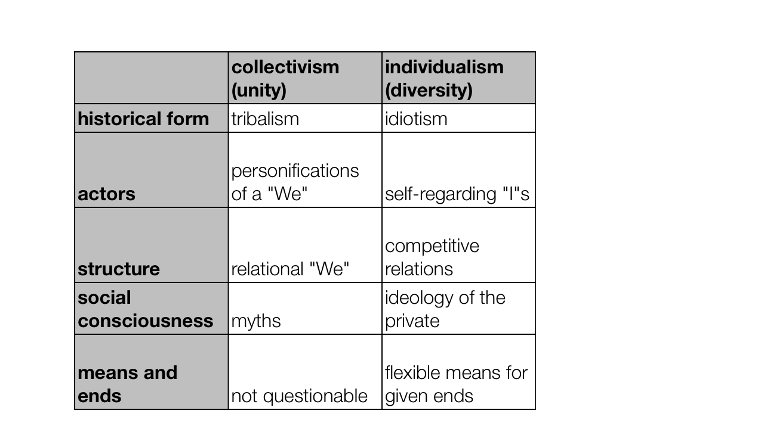
3 Individualism and Collectivism

Slide 6
4 Global Challenges
We live in the age of global challenges.
Global challenges are due to disparities in social relations
  between humans and technology
  between humans and nature
  among humans

Slide 7
4 Global Challenges
Global challenges
  threaten the continuation of humanity through another world war and environmental catastrophes
  can be met only by all humanity: need of global consciousness

Slide 8
4 Global Challenges
We face the choice:
  either breakdown of the interdependent world system because of business as usual
  or breakthrough to a higher-order world system through co-operative action

Slide 9
5 Global Sustainable
Information Society
Framework of requirements:
  first, the change must re-design relations among all humans on earth and between them and nature and technology and build up an integrative new world-system
  – hence globality

Slide 10
5 Global Sustainable
Information Society
Framework of requirements:
  second, the change must establish safeguards against man-made dysfunctions that might, eventually, cause the collapse of the whole world-system
  – hence sustainability

Slide 11
5 Global Sustainable
Information Society
Framework of requirements:
  third, the change must mobilise humanity‘s best intellectual capacities to gain knowledge that allows for the design of the required safeguards
  – hence informationality

Slide 12
5 Global Sustainable
Information Society
Implementation needs, first, social co-operation of actors such that they reflect
- a common goal,
- a common state,
- and a common way to reach the goal,
in the collective supra-system they are integrated with

Slide 13
5 Global Sustainable
Information Society
Implementation needs, second, social communication of actors as interacting individual systems such that they reflect each other‘s reflection on
- goals,
- states,
- and ways,
in relation to the supra-system

Slide 14
5 Global Sustainable
Information Society
Implementation needs, third, social cognition of actors as individual systems such that they reflect
- their own goals,
- the state they are in,
- and the way to reach their goals,
in relation to the supra-system

Slide 15
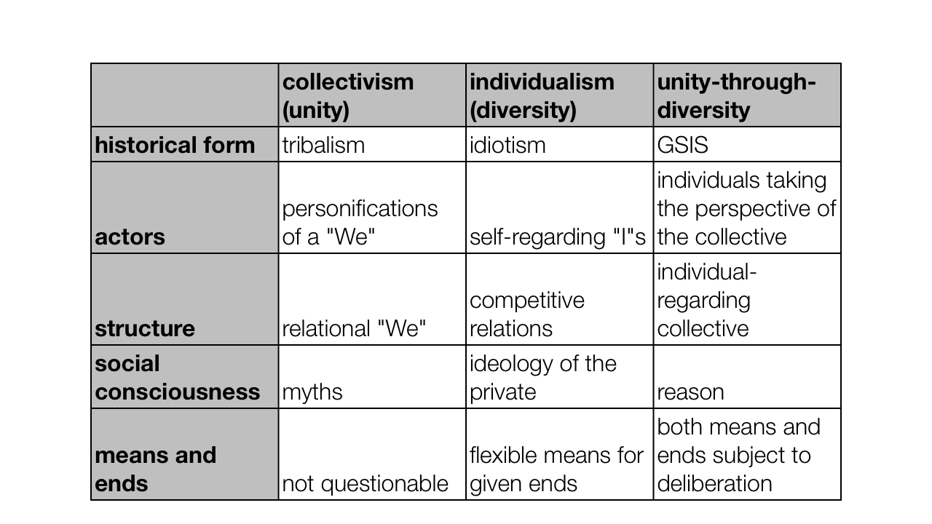
5 Global Sustainable
Information Society

